Slide 1
CS 1520 COMPUTER ARCHITECTURE
Prof. Peter Edwards
p.edwards@abdn.ac.uk
Notes:
Some slides in this set adapted from:
Digital Design and Computer Architecture, 2nd Edition
David Money Harris and Sarah L. Harris

Slide 2
Boolean Algebra & Digital Logic

Slide 3
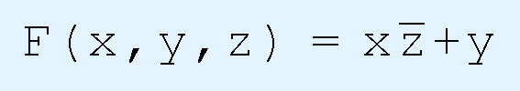
Boolean Functions
A Boolean function has:
At least one Boolean variable,
At least one Boolean operator, and
At least one input from the set {0,1}.
It produces an output that is also a member of the set {0,1}.

Slide 4
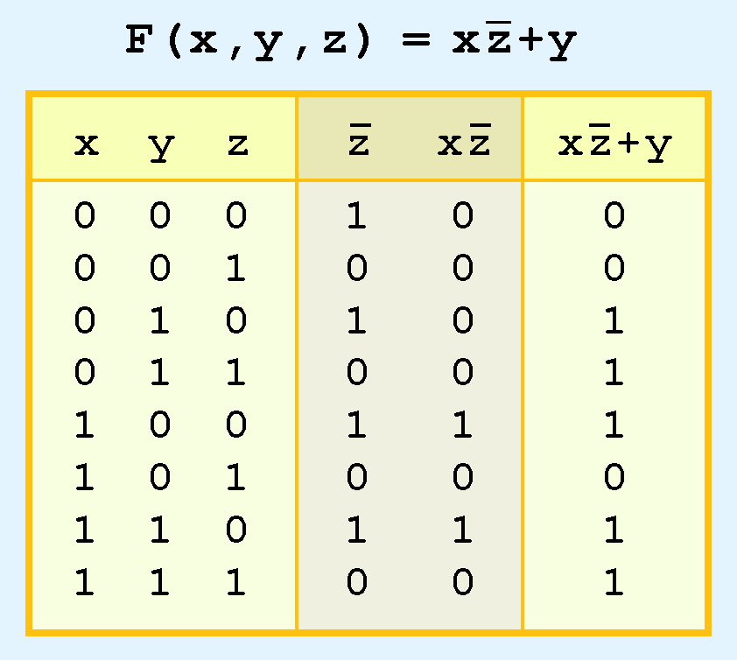
Boolean Functions
The truth table for the Boolean function: is shown to the right.
To make evaluation of the Boolean function easier, the truth table contains extra (shaded) columns to hold evaluations of subparts of the function.
NOT > AND > OR precedence
Notes:
As with common arithmetic, Boolean operations have rules of precedence.
The NOT operator has highest priority, followed by AND and then OR.
This is how we chose the (shaded) function subparts in our table.

Slide 5
Logic Circuits
A logic circuit is composed of:
Inputs
Outputs
Functional specification
Timing specification
Example:
Nodes
Inputs: A, B, C
Outputs: Y, Z
Internal: n1
Circuit elements
E1, E2, E3
Each a circuit

Slide 6
Functional Specification
Specification of outputs in terms of inputs.
Example:
S = F(A, B, C_{in})
C_{out} = F(A, B, C_{in})
Notes:
CL in box indicates that this function is implemented only using combinational logic – More on that later!
For now: Combinational logic is Memoryless and Outputs are determined by current values of inputs.
This example is actually a significant one – it is a FULL ADDER – More on this later too!

Slide 7
The Simplicity Principle
Digital computers contain circuits that implement Boolean functions.
The simpler that we can make a Boolean function, the smaller the circuit that will result.
Simpler circuits are cheaper to build, consume less power, and run faster than complex circuits.
With this in mind, we always want to reduce our Boolean functions to their simplest form.
There are a number of aspects of Boolean algebra that help us to do this.

Slide 8
Boolean Simplification
Axioms and theorems to simplify Boolean equations.
Like regular algebra, but simpler: variables have only two values (1 or 0)
Duality in axioms and theorems:
Operators ANDs and ORs, symbols 0’s and 1’s are interchanged.
Notes:
DUALITY:
Most Boolean identities have an AND (product) form as well as an OR (sum) form. We give our identities using both forms.

Slide 9
Boolean Axioms
 | Axiom |  | Dual | Name
A1 | B = 0 if B ≠ 1 | A1’ | B = 1 if B ≠ 0 | Binary field
A2 | 0 = 1 | A2’ | 1 = 0 | NOT
A3 | 0 • 0 = 0 | A3’ | 1 + 1 = 1 | AND/OR
A4 | 1 • 1 = 1 | A4’ | 0 + 0 = 0 | AND/OR
A5 | 0 • 1 = 1 • 0 = 0 | A5’ | 1 + 0 = 0 + 1 = 1 | AND/OR
A1 states that a Boolean variable B is 0 if it is not 1
A1’ states that the variable is 1 if it is not 0.
A1 and A1’ shows the binary field

Slide 10
Boolean Theorems
 | Theorem |  | Dual | Name
T1 | B • 1 = B | T1’ | B + 0 = B | Identity
T2 | B • 0 = 0 | T2’ | B + 1 = 1 | Null Element
T3 | B • B = B | T3’ | B + B = B | Idempotence
T4 | B = B |  |  | Involution
T5 | B • B = 0 | T5’ | B + B = 1 | Complement
The table shows how to simplify equations involving one variable.

Slide 11
Boolean Axioms
T1 (Identity)
B • 1 = B
B + 0 = B
We can replace the gate with a wire.
T2 (Null Element)
B • 0 = 0
B + 1 = 1
Replace the gate with a wire that is tied LOW (to 0).
Replace the gate with a wire that is tied HIGH (to 1).

Slide 12
Boolean Axioms
T3 (Idempotence)
B • B = B
B + B = B
T4 (Involution)
B = B

Slide 13
Boolean Axioms
T5 (Complement)
B • B = 0
B + B = 1

Slide 14
Boolean Theorems of Several Variables
 | Theorem |  | Dual | Name
T6 | B • C = C • B | T6’ | B + C = C + B | Commutativity
T7 | (B • C) • D = B • (C • D) | T7’ | (B + C) + D = B + (C + D) | Associativity
T8 | (B • C) + B • D = B • (C + D) | T8’ | (B + C) • (B + D) = B + (C • D) | Distributivity
T9 | B • (B + C) = B | T9’ | B + (B • C) = B | Covering
T10 | (B • C) + (B • C) = B | T10’ | (B + C) • (B + C) = B | Combining
T11 | (B • C) + (B • D) + (C • D) = B • C + B • D | T11’ | (B + C) • (B + D) • (C + D) = (B + C) • (B + D) | Consensus
T12 | B₀ • B₁ • B₂ … = (B₀ + B₁ + B₂ ...) | T12’ | B₀ + B₁ + B₂ ... = (B₀ • B₁ • B₂ …) | De Morgan’s Theorem

Slide 15
De Morgan’s Theorem
Y = AB = A + B
The complement of the product of all the terms is equal to the sum of the complement of each term.
Y = A + B = A•B
The complement of the sum of all the terms is equal to the product of the complement of each term.

Slide 16
De Morgan’s Theorem
Y = AB = A + B
Graphical representation – note movement of the bubbles!
Y = A + B = A•B

Slide 17
Bubble Pushing
Bubble pushing is a technique to apply De Morgan's theorem directly to a logic diagram.
Backward:
Body changes
Adds bubbles to inputs
Forward:
Body changes
Adds bubble to output
Notes:
A graphical aid to simplification.

Slide 18
Bubble Pushing Example
Begin at output, then work toward inputs.
Push bubbles on final output back.
Draw gates in a form so bubbles cancel.

Slide 19

Simplification Example
We can simplify the function:
as follows:
(X + Y) (X + Y) (XZ) Rewriting (X + Y) (X + Y) (X + Z) DeMorgan’s Theorem (XX + XY + XY + YY) (X + Z) Distributivity ( ( X + YY) + X (Y + Y) ) (X + Z) Commutativity/Distributivity ( ( X + 0) + X (1) ) (X + Z) Complements X (X + Z) Idempotency XX + XZ Distributivity 0 + XZ Complements XZ Idempotency

Slide 20
Boolean Expressions
Through our exercises in simplifying Boolean expressions, we see that there are numerous ways of stating the same Boolean expression.
These “synonymous” forms are logically equivalent.
Logically equivalent expressions have identical truth tables.
In order to eliminate as much confusion as possible, designers express Boolean functions in standardized or canonical form.

Slide 21
Canonical Forms
There are two canonical forms for Boolean expressions:
sum-of-products
product-of-sums
Remember: Boolean product is the AND operation and the Boolean sum is the OR operation.
In the sum-of-products form
ANDed variables are ORed together.
In the product-of-sums form
ORed variables are ANDed together.
Notes:
Minterm: product (AND) that includes all input variables - both originals and complements
Maxterm: sum (OR) that includes all input variables - both originals and complements

Slide 22
Sum-of-Products (SOP)
All equations can be written in SOP form
Each truth table row has a minterm
A minterm is a product (AND) of input variables
Each minterm is TRUE for that row (and only that row)
Form function by ORing minterms where the output is TRUE
Thus, a sum (OR) of products (AND terms)
Y = F(A, B) = AB + AB = Σ(1, 3)
Notes:
Minterm: product (AND) that includes all input variables - both originals and complements
It is easy to convert a function to sum-of-products form using its truth table.
We are interested in the values of the variables that make the function true (=1).
Using the truth table, we list the values of the variables that result in a true function value.
Each group of variables is then ORed together.
IMPORTANT NOTE:
Our aim here is only to rewrite our function in canonical sum-of-products form - it may not be in its simplest form however…

Slide 23
Product-of-Sums (POS)
All Boolean equations can be written in POS form
Each truth table row has a maxterm
A maxterm is a sum (OR) of literals
Each maxterm is FALSE for that row (and only that row)
Form function by ANDing the maxterms for which the output is FALSE
Thus, a product (AND) of sums (OR terms)
Y = F(A, B) = (A + B)(A + B) = Π(0, 2)
Notes:
Maxterm: sum (OR) that includes all input variables - both originals and complements

Slide 24
Canonical Forms - Example
You are going to the cafeteria for lunch
You won’t eat lunch (E)
If it’s not open (O) or
If they only serve curry (C)
Write a truth table for determining if you will eat lunch (E).

Slide 25
Canonical Forms - Example
SOP – sum-of-products
POS – product-of-sums
E = OC
= Σ(2)
E = (O + C)(O + C)(O + C)
= Π(0, 1, 3)
Notes:
REMEMBER for POS - We are interested in the rows for which output (E) is FALSE.

